Slide 1
Software Integration & Maintenance
Fahim Foysal Abak
Lecture, Dept. of CSE
Dhaka International University

Slide 2
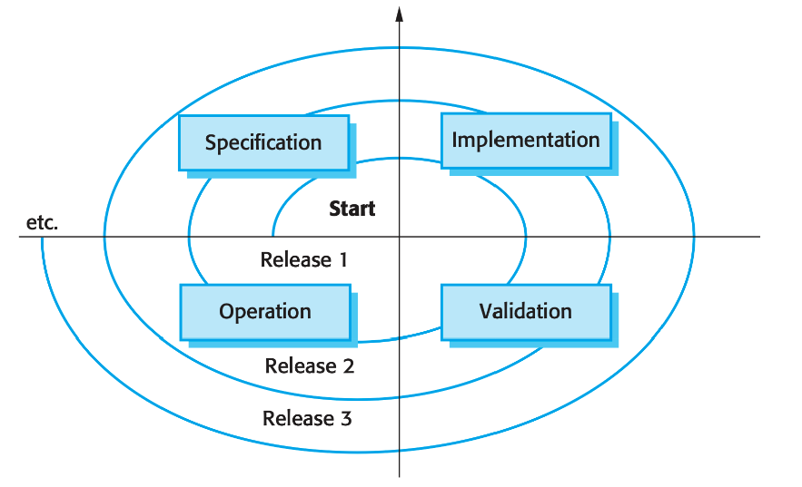
Software Maintenance
Agenda:
  • Introduction to Software Maintenance
  • Need for Maintenance
  • Types of Maintenance
  • Maintenance Process
  • Maintenance Cost
  • Maintenance Strategies
  • Factors Affecting Maintenance Cost
  • Legacy Systems

Slide 3
Software Maintenance
Software maintenance is the process of modifying a software system after delivery to correct faults, improve performance, or adapt it to a changed environment.
Example:
A university uses a Result Management System to calculate and publish student grades.
Problem:
After deployment, students report that CGPA is calculated incorrectly when a course is repeated.
Maintenance Action:
Developers identify a logic error in the grading algorithm and fix it.

Slide 4
Software Maintenance
Problem:
The university upgrades its database from MySQL to PostgreSQL.
Maintenance Action:
The software is modified so it can run correctly with the new database.
Problem:
Users request a new feature to download results as a PDF.
Maintenance Action:
Developers add a “Download PDF” option and improve the user interface.
Problem:
The system code is old, poorly structured, and hard to understand.
Maintenance Action:
The team refactors the code, improves documentation, and removes unused modules.

Slide 5
Why Software Maintenance?
Business requirements change
Bugs appear after deployment
Environment & technology evolve
Performance improvements needed
Notes:
Bugs appear after deployment: Teachers complain korlo je repeated course er marks update korar por CGPA wrong show kortese. Testing er time eta dhora poreni. After the mobile banking app is released, some users report that money is deducted from their account, but the transaction status shows “failed.”
Environment & technology evolve: Database, OS, browser, server, framework, security policy change hole system adapt korte hoy.University server MySQL theke PostgreSQL e migrate korlo, or old PHP system ke new Laravel/Django environment e run korte hobe.
Performance improvements needed: Users/data barle software slow hoy; speed improve korte hoy.

Slide 6
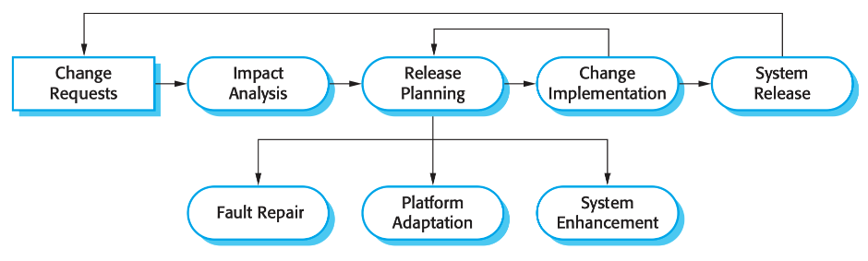
Software Evolution
Software evolution refers to the ongoing development of software systems after initial deployment.
Figure: The software evolution process
Notes:
Change Request
User/new requirement ashe
Banking app e user bole: “Mobile recharge option chai.”
Impact Analysis
Change korle kon kon part affect hobe check kora
Recharge feature add korle payment, balance, transaction history affect hobe kina dekha
Release Planning
Kon change next version e deya hobe decide kora
Team decide korlo next update e recharge + bug fix release hobe
System Release
Updated software user der jonno release kora
Banking app version 2.0 publish kora
Fault Repair: bug fix
Example: Money deducted but transaction failed show kore. Eta fix kora.
Platform Adaptation: new technology/environment e adapt kora
Example: App old Android version theke new Android version e support kora.
System Enhancement: new feature/improvement add kora
Example: Mobile recharge, QR payment, biometric login add kora

Slide 7
Lehman’s Laws of Software Evolution
Continuing Change
Increasing Complexity
Large Program Evolution
Organizational Stability
Conservation of Familiarity
Continuing growth
Declining quality
Feedback system
Notes:
1. Continuing Change
Software must keep changing to remain useful.
Student portal needs online payment because students now pay digitally.
Software that didn’t continuously change - Internet Explorer, Yahoo Messenger, Windows Phone, Skype.
2. Increasing Complexity
As new features are added, the software becomes more complex.
Adding payment, LMS, and notification modules makes the system harder to manage.
3. Self-Regulation
Software evolution follows a pattern and is controlled by team capacity, cost, and time.
The team cannot add 20 features in one week; changes happen gradually.
Organizational Stability
Adding more developers to a project does not drastically speed up the work. The average output (work rate) of a software project remains mostly constant over time because of communication overhead.
5. Conservation of Familiarity
Too many changes at once make the system hard to understand.
If the whole student portal interface changes suddenly, students and staff may become confused.
6. Continuing Growth
Software must grow by adding new features.
The portal adds mobile app support and library integration.
7. Declining Quality
If software is not maintained properly, its quality decreases.
Old code, bugs, and slow performance make the portal unreliable.
8. Feedback System
Software improves based on feedback from users and the environment.
Students complain that course registration is slow, so developers optimize the system.

Slide 8
Lehman’s Laws of Software Evolution
Law | Description
Continuing change | A program that is used in a real-world environment must necessarily change, or else become progressively less useful in that environment.
Increasing complexity | As an evolving program changes, its structure tends to become more complex. Extra resources must be devoted to preserving and simplifying the structure.
Large program evolution | Program evolution is a self-regulating process. System attributes such as size, time between releases, and the number of reported errors is approximately invariant for each system release.
Organizational stability | Over a program’s lifetime, its rate of development is approximately constant and independent of the resources devoted to system development.

Slide 9
Lehman’s Laws of Software Evolution
Law | Description
Conservation of familiarity | Over the lifetime of a system, the incremental change in each release is approximately constant.
Continuing growth | The functionality offered by systems has to continually increase to maintain user satisfaction.
Declining quality | The quality of systems will decline unless they are modified to reflect changes in their operational environment.
Feedback system | Evolution processes incorporate multiagent, multiloop feedback systems and you have to treat them as feedback systems to achieve significant product improvement.

Slide 10
Types of Software Maintenance
Fault repairs: Coding errors are usually relatively cheap to correct; design errors are more expensive as they may involve rewriting several program components. Requirements errors are the most expensive to repair because of the extensive system redesign which may be necessary.
Environmental adaptation: This type of maintenance is required when some aspect of the system’s environment such as the hardware, the platform operating system, or other support software changes. The application system must be modified to adapt it to cope with these environmental changes.
Functionality addition: This type of maintenance is necessary when the system requirements change in response to organizational or business change. The scale of the changes required to the software is often much greater than for the other types of maintenance.

Slide 11
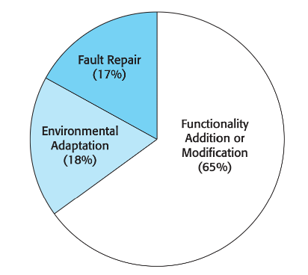
Types of Software Maintenance
Corrective: Fixes errors and bugs discovered after deployment.
Adaptive: Changes made to keep software usable in a changing environment.
Perfective: Enhancements to improve performance or maintainability.
Preventive: Changes to prevent future problems.
Figure: Maintenance effort distribution

Slide 12
Maintenance Cost
Software maintenance takes up a higher proportion of IT budgets than new development (roughly two-thirds maintenance, one-third development).
The relative costs of maintenance and new development vary from one application domain to another. Guimaraes (1983) found that the maintenance costs for business application systems are broadly comparable with system development costs.
In embedded real-time systems, maintenance costs can be up to four times higher than development costs.
These systems require very high reliability and performance, which leads to:
  Tightly coupled modules
  Strong interdependencies between components
Because of tight coupling, making changes becomes difficult and expensive.

Slide 13
Factors Increasing Software Maintenance Cost
It is usually more expensive to add functionality after a system is in operation than it is to implement the same functionality during development. The reasons for this are:
Team Stability
  After delivery, the original development team often disperses.
  New maintenance staff lack system and design knowledge.
  Extra time is needed to understand the system before making changes.
Poor Development Practice
  Maintenance is usually handled under a separate contract.
  Often done by a different company than the developer.
  Developers may not focus on maintainability to save development effort.
Staff Skills
  Maintenance is often assigned to junior or less experienced staff.
  Maintenance work has a poor reputation among engineers.
  Older systems may use obsolete languages unfamiliar to current staff.

Slide 14
Factors Increasing Software Maintenance Cost
Program Age and Structure
  As software ages, repeated changes degrade program structure.
  Poor structure makes the system harder to understand and modify.
  Older systems may lack modern software engineering practices.
  Many were optimized for efficiency rather than readability.
  Documentation may be missing, outdated, or inconsistent.
  Weak or absent configuration management makes it difficult to find correct versions of components.

Slide 15
Software Maintenance Strategies
Quick Fix: Fast changes to correct issues but may increase complexity.
Iterative enhancement: Regular planned updates improving quality and functionality.
Component replacement
System re-engineering: Improving structure without changing functionality.

Slide 16
Software Reengineering
Software Reengineering focuses on improving the internal structure of existing software without changing its external behavior.
According to Sommerville:
  Software reengineering is the examination and alteration of a system
  It is followed by reconstruction in a new form
  The system’s functionality remains the same
  Main goal: reduce future maintenance costs

Slide 17
Why Software Reengineering is Needed
Reengineering is required because:
  Legacy systems are business-critical
  Systems are difficult to maintain
  Code structure has degraded over time
  Documentation is outdated or missing
  Replacing systems is risky and expensive

Slide 18
Reengineering vs Replacement
Reengineering | Replacement
Lower risk | High risk
Incremental | Big bang
Preserves knowledge | Knowledge lost
Faster results | Long development time
Sommerville recommends reengineering when system quality is poor but functionality is valuable.

Slide 19
Software Reengineering Activities
Four main reengineering activities:
  Source Code Translation
  Reverse Engineering
  Program Structure Improvement
  Data Reengineering

Slide 20
Legacy systems
Legacy systems are old systems that are still useful and are sometimes critical to business operation.
They may be implemented using outdated languages and technology or may use other systems that are expensive to maintain.
Often their structure has been degraded by change and documentation is missing or out of date.

Slide 21
Legacy system management
Scrap the system completely: This option should be chosen when the system is not making an effective contribution to business processes. This commonly occurs when business processes have changed since the system was installed and are no longer reliant on the legacy system.
Leave the system unchanged and continue with regular maintenance: This option should be chosen when the system is still required but is fairly stable and the system users make relatively few change requests.

Slide 22
Legacy system management
Reengineer the system to improve its maintainability: This option should be chosen when the system quality has been degraded by change and where a new change to the system is still being proposed. This process may include developing new interface components so that the original system can work with other, newer systems.
Replace all or part of the system with a new system This option should be chosen when factors, such as new hardware, mean that the old system cannot continue in operation or where off-the-shelf systems would allow the new system to be developed at a reasonable cost.

Slide 23
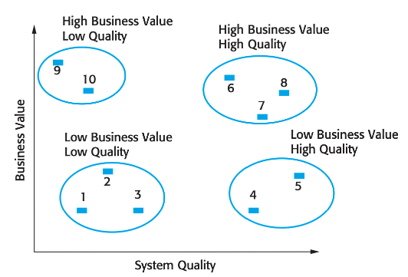
Legacy system management
Figure: An example of a legacy system assessment
1. Low quality, low business value Keeping these systems in operation will be expensive and the rate of the return to the business will be fairly small. These systems should be scrapped.
2. Low quality, high business value These systems are making an important business contribution so they cannot be scrapped. However, their low-quality means that it is expensive to maintain them. These systems should be reengineered to improve their quality. They may be replaced, if a suitable off-the-shelf system is available.

Slide 24
Legacy system management
Figure: An example of a legacy system assessment
3. High quality, low business value These are systems that don’t contribute much to the business but which may not be very expensive to maintain. It is not worth replacing these systems so normal system maintenance may be continued if expensive changes are not required and the system hardware remains in use. If expensive changes become necessary, the software should be scrapped.

Slide 25
Legacy system management
Figure: An example of a legacy system assessment
4. High quality, high business value These systems have to be kept in operation. However, their high-quality means that you don’t have to invest in transformation or system replacement. Normal system maintenance should be continued.

Slide 26
Thank You.

